Slide 1

VOLLEYBALL
“Mintonette”
Wilfredo E Villaruz Jr.
BsEd-MAPEH III
Saint Louis University, Baguio City

Slide 2
CHARACTERISTIC OF VOLLEYBALL
Volleyball is a team sport played by two teams on playing court divided by a net. The object of the game is to send the ball over the net in order to ground it on the opponent’s court and to prevent the same effort by the opponent. The team has three hits for returning the ball (except to block contact). A player may hit the ball any part of the body.
The ball is to put into play with a service: hit by the server over the net to the opponents. The rally continues until the ball grounded on to paying court, goes out or team fails to return it properly.
In volleyball, the team winning a rally scores a point (Rally Point System). When the receiving team wins a rally, it gains a point and the right to serve, and its players rotate one position clockwise.

Slide 3
SUB-TOPIC
History of volleyball
Types of volleyball game
Characteristic of volleyball
Basic skills of volleyball
Equipment
Official of the Game
Participants
Faults or Violations
Regular game interruption
Libero player
Notes:
Faults and Violations

Slide 4
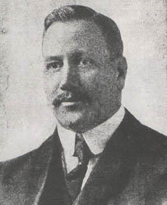
William G. Morgan (1870-1942), who was born in the State of New York, has gone down in history as the inventor of the game of Volleyball, to which he originally gave the name "Mintonette".
The young Morgan carried out his undergraduate studies at the Springfield College of the YMCA (Young Men's Christian Association) where he met James Naismith who, in 1891, had invented basketball. After graduating, Morgan spent his first year at the Auburn (Maine) YMCA after which, during the summer of 1895, he moved to the YMCA at Holyoke (Massachusetts) where he became Director of Physical Education. In this role he had the opportunity to establish, develop and direct a vast programmed of exercises and sport classes for male adults. In the end.
Morgan asked the firm of A.G. Spalding & Bros. to make a ball, which they did at their factory near Chicopee, in Massachusetts. The result was satisfactory: the ball was leather-covered, with a rubber inner tube, its circumference was not less than 25 and not more than 27 inches (63.5 cm and 68.6 cm, respectively), and its weight not less than 9 and not more than 12 ounces (252 gr and 336 gr, respectively).
Morgan explained that the new game was designed for gymnasia or exercise halls, but could also be played in open air. An unlimited number of players could participate, the object of the game being to keep the ball in movement over a high net, from one side to the other.
Mr. Morgan explained the rules and worked on them, then gave a hand-written copy to the conference of YMCA directors of physical education, as a guide for the use and development of the game. A committee was appointed to study the rules and produce suggestions for the game's promotion and teaching.
A brief report on the new game and its rules was published in the July 1896 edition of "Physical Education" and the rules were included in the 1897 edition of the first official handbook of the North American YMCA Athletic League.
William G. Morgan, the creator of Volleyball

Slide 5
History of Volleyball
1895 –Volleyball originally called MINTONETTE was initiated by William J. Morgan in Holyoke, Massachusetts, USA.
1896 -Prof. H. T. Halsted of Springfield, Massachusetts, USA suggested that the name changed to VOLLEYBALL based on his idea that the ball is played through the use of the hand and arms by volleying over the net.
1910- Prof. Edgar S. Brown introduced volleyball game in the Philippines.
1916- in the Philippines, an offensive style of passing the ball in a high trajectory to be struck by another player (the set and spike) were introduced. The Filipinos developed the "bomba" or kill, and called the hitter a "bomberino".
1916 - The NCAA was invited by the YMCA to aid in editing the rules and in promoting the sport. Volleyball was added to school and college physical education and intramural programs.
1917-the game was changed from 21 to 15 points.
1947-the Federation International Volley-Ball (FIVB) was founded in Paris.
1955 - Pan American Games included volleyball
1986- the Women's Professional Volleyball Association (WPVA) was formed.
1987- the FIVB added a Beach Volleyball World Championship Series.
1988-the US Men repeated the Gold in the Olympics in Korea.
1989- the FIVB Sports Aid Program was created.
1990- the World League was created.
1992-the Four Person Pro Beach League was started in the United States.
1994-Volleyball World Wide, created.
1995-the sport of Volleyball was 100 years old!
1996-2-person beach volleyball was added to the Olympics

Slide 6
Types of volleyball game
Far Eastern Rule
International Rule
Beach Volleyball or Park Volleyball

Slide 7
Playing court
The playing court is rectangular, 16m long by 8m wide. It is surrounded by a free zone a minimum of 3m wide and space free from obstruction up to a height of a minimum of 7m from the playing surface.
The terrain is levelled sand, flat and uniform as possible, free of rocks, shells and anything else to avoid risks of cuts or injuries to the players.
Two sidelines and two end lines mark the playing court. All lines are 5cm−8cm wide and are a colour that contrasts with the colour of the sand. There is no service area designated as players may serve from anywhere across the back line. There is no centre line

Slide 8
The net
The net serves as a visible centre line of the court, dividing it into two halves. The net is 8.5m long and 1m wide when hung taut. It is 10cm square mesh. The height of the net is 2.43m for men and 2.24m for women. The posts supporting the net must be rounded and smooth, with a height of 2.55m, preferably adjustable. The posts must be padded.

Slide 9
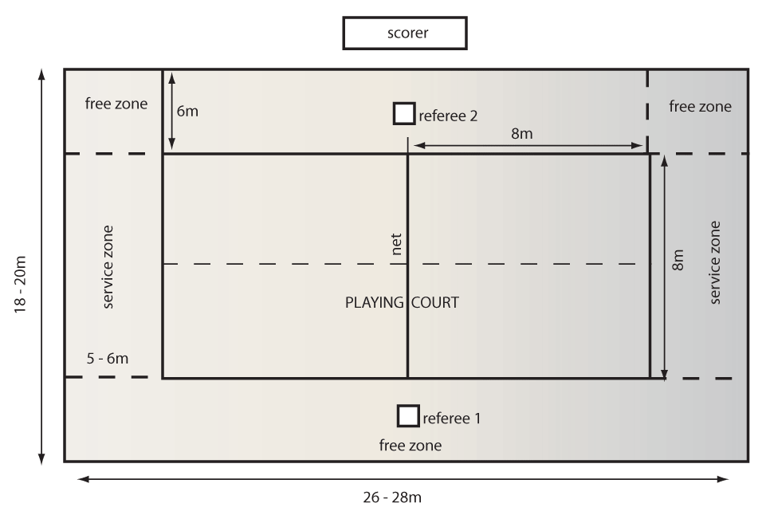

Slide 10
Playing court
The playing court is rectangular, 18m long and 9m wide. The space around the court or ‘free zone’ is a minimum of 3m on all sides.
The ‘free playing space’ is above the playing area and must be free of any obstructions. This is a minimum height of 7m from the playing surface.
For official or Federation of International Volleyball (FIVB) competitions, the free zone is 5m from the sidelines and 8m from the end lines. The free playing space is 12.5m in height from the playing surface.

Slide 11
Net and posts
The net is 1m wide and 9.5m−10m long and is made of 10cm square, black mesh. The top of the net is 2.43m high for men and 2.24m for women. The height is measured from the centre of the playing court.
A flexible rod 1.8m long and 10mm in diameter called an antenna is fastened at the outside edge of each side band on the net. Antenna are placed on opposite sides of the net and are considered part of the net. Antenna laterally delimit the crossing space.
The posts supporting the net are 0.50m−1m outside the sidelines. They are 2.55m high. The posts are round and smooth, fixed to the ground without wires.

Slide 12
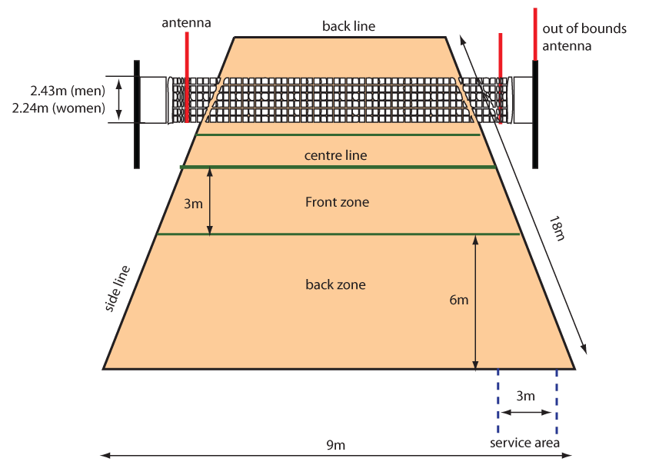

Slide 13
Serving
Passing
Setting
Spike
Blocking
Notes:
Serving
Passing
Setting
Blocking

Slide 14





Serving
Is to act of putting the ball into play by hitting it with the hand at back of the end line.
Serving is a fundamental volleyball skill that every player should strive to master

Slide 15
Kinds of serve
Notes:
Kinds of serve

Slide 16
Underhand Serve
Refers to whether the player strikes the ball from below, at waist level, or first tosses the ball in the air and then hits it above shoulder level. Underhand serve is considered very easy to receive and is rarely employed in high-level competitions.
Jump Serve
An overhand serve where the ball is first tossed high in the air, then the player makes a timed approach and jumps to make contact with the ball. There is usually much topspin imparted on the ball. This is the most popular serve amongst college and professional teams.

Slide 17
Floater Serve an overhand serve where the ball is hit with no spin so that its path becomes unpredictable. This type of serve can be administered while jumping or standing. This is akin to a knuckleball in baseball.

Slide 18
Passing
Is used to receive the ball through the use the fingers or arms and pass it to the teammate. The purpose is too direct the ball to the tea’s setter who initiates the offense.

Slide 19
Underhand or dig pass
Overhead/set pass

Slide 20
Setting
means of tossing the ball or passing it through the air in positions for a teammate to spike.
a. underhand set
b. overhead set
c. jump set
d. set and roll
e. back set

Slide 21
Underhand or dig pass
Used primarily to receive the serve or strong spike using the forearms. The style of the execution is either interlocked or interlaced position.
Overhead/set pass
It allows for better accuracy and control of the ball through the use of the fingers.

Slide 22
Spike
Is the way of hitting the ball forcefully above the net and set it towards the opponent’s courts. The striking hand maybe open or close fist.

Slide 23
Kinds of spike
a. Quick spike
b. Medium spike
c. Open spike
d. Fake spike
Notes:
Kinds of spike

Slide 24
Blocking
Is the action of players close to the net to intercept the ball coming from the opponent by reaching higher than the top the net.
Notes:
Is the action of players close to the net to intercept the ball coming from the opponent by reaching higher than the top the net.

Slide 25
a. Block attempt- is the action of blocking without touching the ball.
b. Collective /Multiple block- is the executed by two or three players close to each other and is completed when one of them touches the ball.
c. Complete block – when the ball is touched by the blocker and made a successful block.
Notes:
c. Complete block – when the ball is touched by the blocker and made a successful block.

Slide 26
Equipment

Slide 27
Net
Length- 9.5 meters
Width- 1.0 meter
Square black mesh- 10 cms.
Height of the net for boys- 2.43 meters
Height of the for women- 2.24 meters
Notes:
Length- 9.5 meters
Width- 1.0 meter
Square black mesh-10 cms.
Height of the net for boys- 2.43 meters
Height of the for women- 2.24 meters

Slide 28
Antenna
Flexible rod with 1.80 meters long and 10mm. In diameters, made of fiber glass or similar material.
Notes:
Flexible rod with 1.80 meters long and 10mm. In diameters, made of fiber glass or similar material.

Slide 29
Post
0.50- 1.00 m long from the sidelines.
2.55 meters high and preferable adjustable.
Notes:
0.50- 1.00 m long from the sidelines.
2.55 meters high and preferable adjustable.

Slide 30
Ball
Size- 65-67 cms. In circumference
Weight- 260-280 grams
must be leather, colored, light color or a combination of color.
Notes:
Size- 65-67 cms. In circumference
Weight- 260-280 grams
Must be leather, colored, ligth color or a combintion of color.

Slide 31
Official of the Game
First Referee
Second Referee
Score Keeper
Line Judges
Notes:
First Referee
Second Referee
Score keeper
Line judges

Slide 32
Participants
Team composition
Location of the Team
Equipment
Notes:
Participants

Slide 33
Team Composition
A team may consist of up to 12 players, one coach, one assistant coach, one trainer and one medical doctor.
For FIVB, World and Official Compositions, the medical doctor must be accredited beforehand by the FIVB.
For FIVB and World Compositions for Seniors, a team may consist of a maximum of fourteen players(a maximum of twelve regular players).
Notes:
A team may consist of up to 12 players, one coach, one assistant coach, one trainer and one medical doctor.

Slide 34
Location of the Team
The players not play in play should either sit on their team bench or be in their warm-up area.
The coach and other team members sit on the bench, but may temporarily leave it.
The benches for the teams are located beside the scores table, outside the free zone.
Notes:
The players not play in play should either sit on their team bench or be in their warm-up area.
The coach and other team members sit on the bench, but may temporarily leave it.

Slide 35
Equipment
A players equipment consists of jersey, shorts, socks must and sport shoes
Players jerseys must be numbered from 1 to 18.
For FIVB, world and Compositions, players jerseys must be numbered 1 to 20.
Notes:
A players equipment consists of jersey, shorts, socks must and sport shoes

Slide 36
Faults or Violations
Team Hits
Contact with the Net
Positional fault
Rotational Fault
Lifting
Attack Hit Fault
Blocking fault
Serving Fault
Notes:
a. Ball Out
b. Team Hits
c. Reaching Beyond the Net
d. Penetration Under the Net
e. Contact with the Net
f. Positional fault
g. Rotational Fault
h. Lifting
i. Attack Hit Fault
j. Blocking fault
k. Serving Fault

Slide 37
Serving Fault
serving out of rotational
Ball not toss
Stepping or entering the line before serving
Service attempt
Serving the ball using foot/feet.
when the libero serve.
Serving with both hand
The server must hit the ball within eight seconds.
Notes:
serving out of rotational
Ball not toss
Stepping or entering the line before serving
Service attempt
Serving the ball using foot/feet.
when the libero serve.
Serving with both hand
The server must hit the ball within eight seconds.

Slide 38
Blocking Fault
Blocking the serve ball
A libero attempts an individual or collective block
Blocking the opponents serve
A back row players or a libero player completes a block or participates in a completed block
Notes:
Blocking the serve ball
A libero attempts an individual or collective block
Blocking the opponents serve
A back row players or a libero player completes a block or participates in a completed block

Slide 39
Attack Hit Fault
A player hits the ball within the playing surface of the opposing team.
A player hits the ball out.
A back row player completes an attack hit from the front zone if at the moment of the ball is entirely higher than the top of the net.
A libero complete an attack hit if at the moment of the ball is entirely higher than the top of the net.
Spiking the serve ball.
Notes:
A player hits the ball within the playing surface of the opposing team.
A player hits the ball out.
A back row player completes an attack hit from the front zone if at the moment of the ball is entirely higher than the top of the net.
A libero complete an attack hit if at the moment of the ball is entirely higher than the top of the net.
Spiking the serve ball.

Slide 40
Lifting
A violation which results when a player permits the ball to rest momentarily in his hands as it moves upward.
Notes:
A violation which results when a player permits the ball to rest momentarily in his hands as it moves upward.

Slide 41
Rotational Fault
Is committed when the service is not made according to the rotational order.
Notes:
Is committed when the service is not made according to the rotational order.

Slide 42
Positional fault
The team commits a positional fault, if any player is not in his/her correct positional at the moment the ball is hit by server.
Notes:
The team commits a positional fault, if any player is not in his/her correct positional at the moment the ball is hit by server.

Slide 43
Contact with the net
Contact with net by e player is not a fault, unless it interferes with play.
Players may touch the post, ropes or any object outside the antenna, including the net it self provided that it does not interfere with play.
When the ball is driven into the net causing it to touch an opponent, no fault is committed.
Notes:
contact with net by e player is not a fault, unless it interferes with play.
Players may touch the post, ropes or any object outside the antenna, including the net it self provided that it does not interfere with play.
When the ball is driven into the net causing it to touch an opponent, no fault is committed.

Slide 44
Team hits
Four Hits- a team hits the ball four times before returning it.
Assisted Hit- a players takes support from a team mate or any structure or object in order to reach the ball within the playing area.
Catching/Lifting- a player does not hit the ball properly, and the ball is caught and/or thrown or ball momentarily rest from the hand/s.
Double contact- a player hits the ball twice in succession.
Notes:
Four Hits- a team hits the ball four times before returning it
Assisted Hit- a players takes support from a team mate or any structure or object in order to reach the ball within the playing area.
Catching/Lifting- a player does not hit the ball properly, and the ball is caught and/or thrown or ball momentarily rest from the hand/s.
Double contact- a player hits the ball twice in succession.

Slide 45
Regular game interruption
Time outs
2 time outs per set per team
Each time outs lapsed in 30 seconds.
b. Technical time out
In set 1-4 two technical time outs per set are applied automatically when leading team reaches the 8th and 16th points.
Technical time outs end in sixty seconds.
Notes:
Time outs
2 time outs per set per team
Each time outs lapsed in 30 seconds.
b. Technical time out
In set 1-4 two technical time outs per set are applied automatically when leading team reaches the 8th and 16th points.
Technical time outs end in sixty seconds.

Slide 46
Player substitution
Six substitution is the maximum permitted per team per set, one or more players may substituted at the same time.
A player in the starting line-up may leave and re-enter the game only once.
Only the player whom he substituted may replace a substitute player.
An injured player who cannot continue to play should be substituted legally.
An expelled or disqualified player must be substituted through a legal substitution.
A substitution is illegal if it exceeds the limitations of substitution.
Notes:
Six substitution is the maximum permitted per team per set, one or more players may substituted at the same time.
A player in the starting line-up may leave and re-enter the game only once.
Only the player whom he substituted may replace a substitute player.
An injured player who cannot continue to play should be substituted legally.
An expelled or disqualified player must be substituted through a legal substitution.
A substitution is illegal if it exceeds the limitations of substitution.

Slide 47
Restrictions of the libero
Can not toss the ball in the front zone using the overhead pass.
Can not spike the ball higher than the top of the net.
Can not serve the ball.
He can replace only of the players positioned in the back zone.
can not block or even attempt to block.
Notes:
Can not toss the ball in the front zone using the overhead pass.
Can not spike the ball higher than the top of the net.
Can not serve the ball.
He can replace only of the players positioned in the back zone.
can not block or even attempt to block.

